Slide 1
Project P-187 Book Recommendation System
Group-1
Group members:
Y V Gireesh Chandra
C H Aswanth Reddy
Balaji Nagarajan
Diwakar Murugan
Nikhil Naganur
Vaishnavi Sunil Thalkar
Sattenapalli Murari

Slide 2
Objective
Generate the features from the dataset and use them to recommend the books accordingly to the users.

Slide 3
Data sets
Books.csv
Users.csv
Book-Ratings.csv

Slide 4
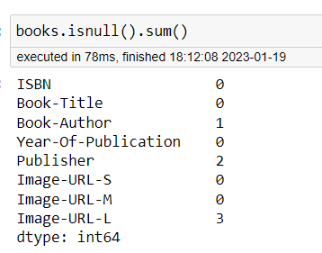
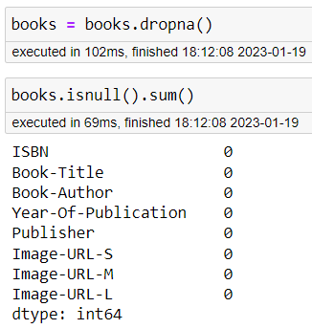
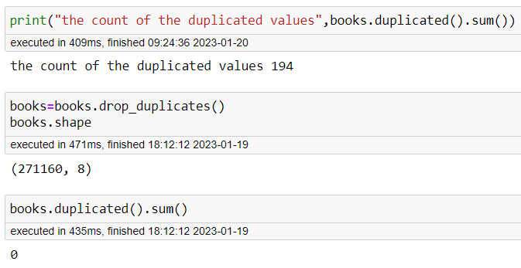
Data Preprocessing
Books dataset
Shape : 271360 rows and 8 columns
Null values
Dropping null values
Duplicates and dropping them

Slide 5
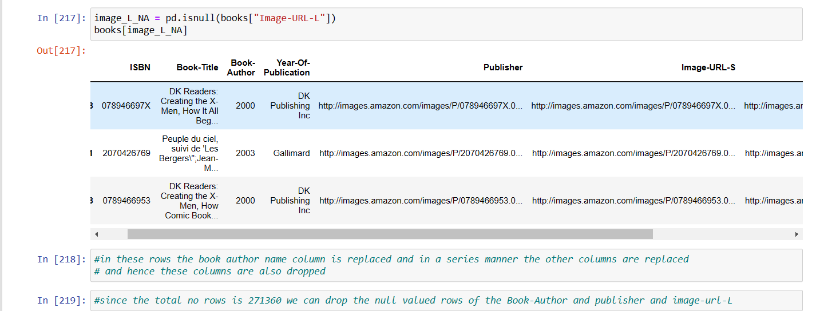
Data Preprocessing
Books dataset
Shape : 271360 rows and 8 columns

Slide 6
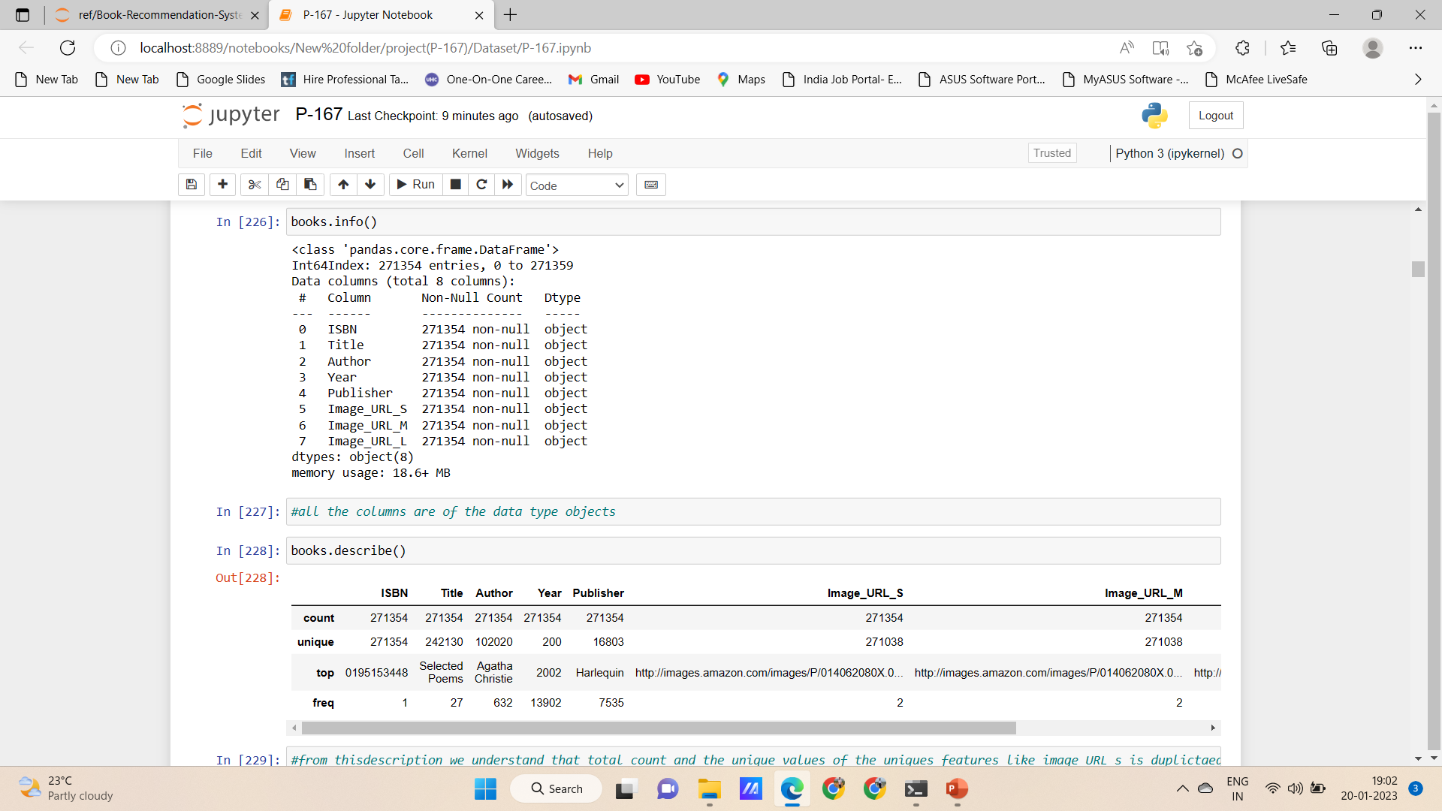
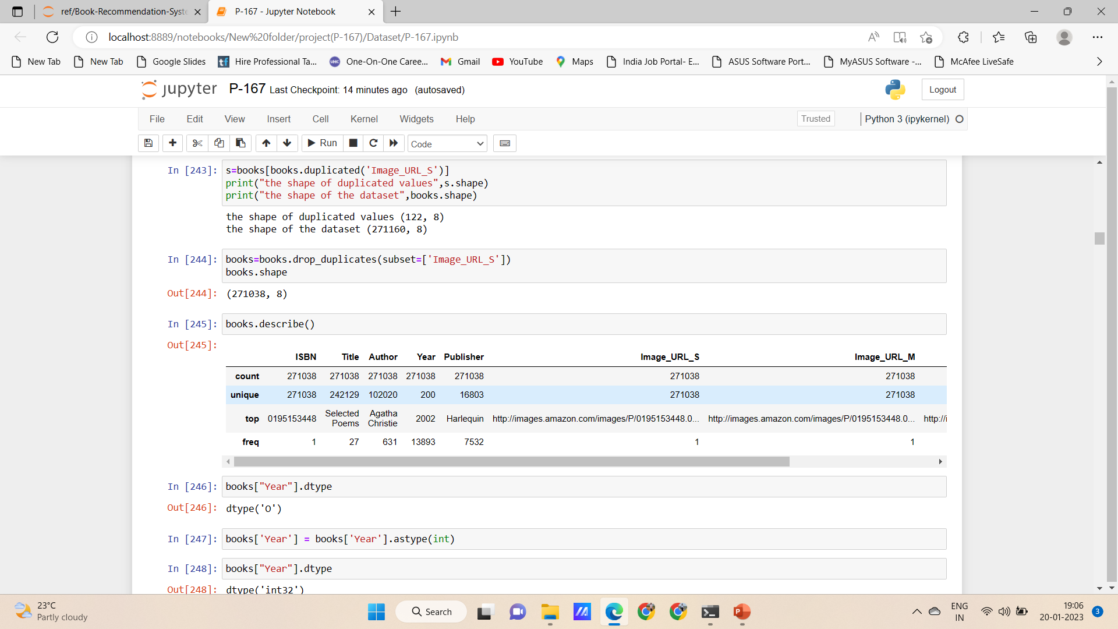
Preprocessing of Books
Duplicate are also due to variation in the count and unique values
This is due to the Upper and Lower cases in the ISBN nos
From this all the duplicated values are dropped
And the description of the counts is found to opted

Slide 7
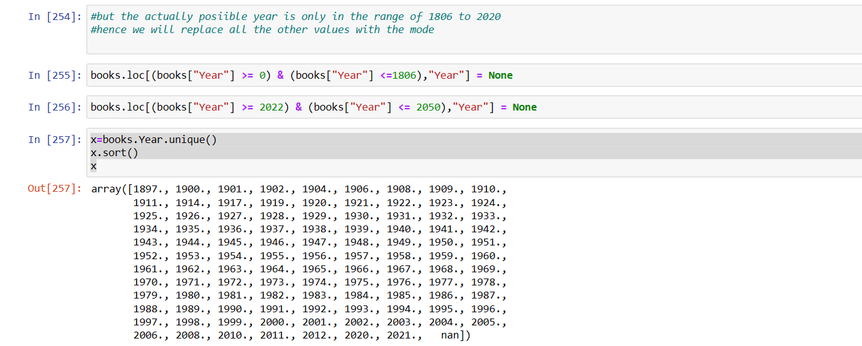
Preprocessing of Books
The Year column in the dataset is found to be insensible as it is the range of 0,1376 to 2050
Hence the data is made into sensible by filtering and imputing certain values
Following this null values imputed with the mode

Slide 8
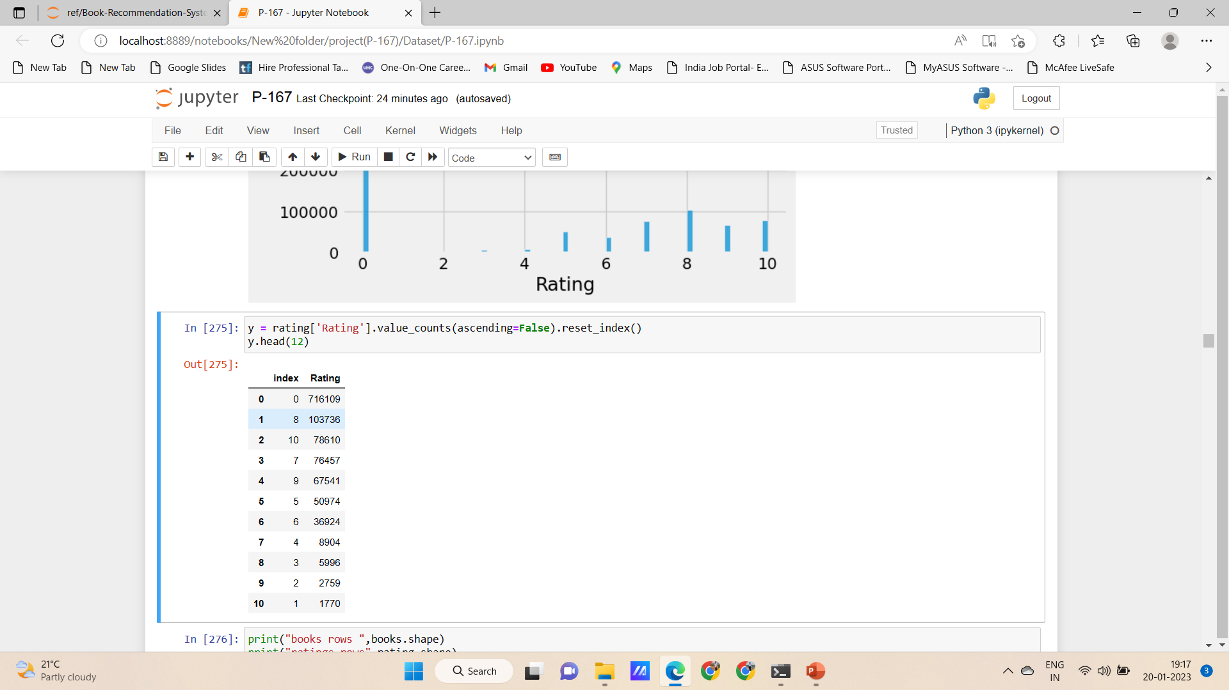
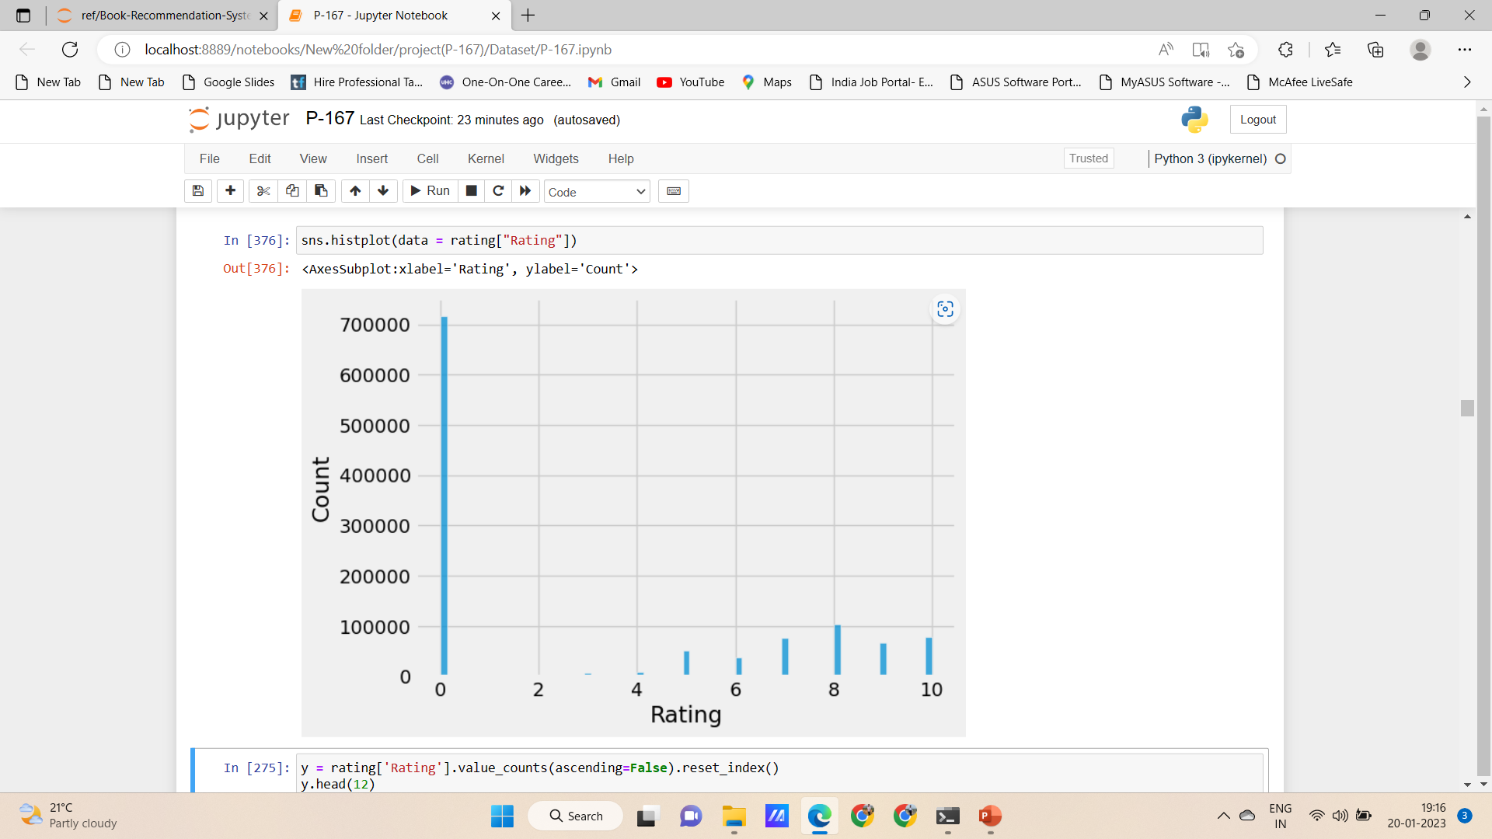
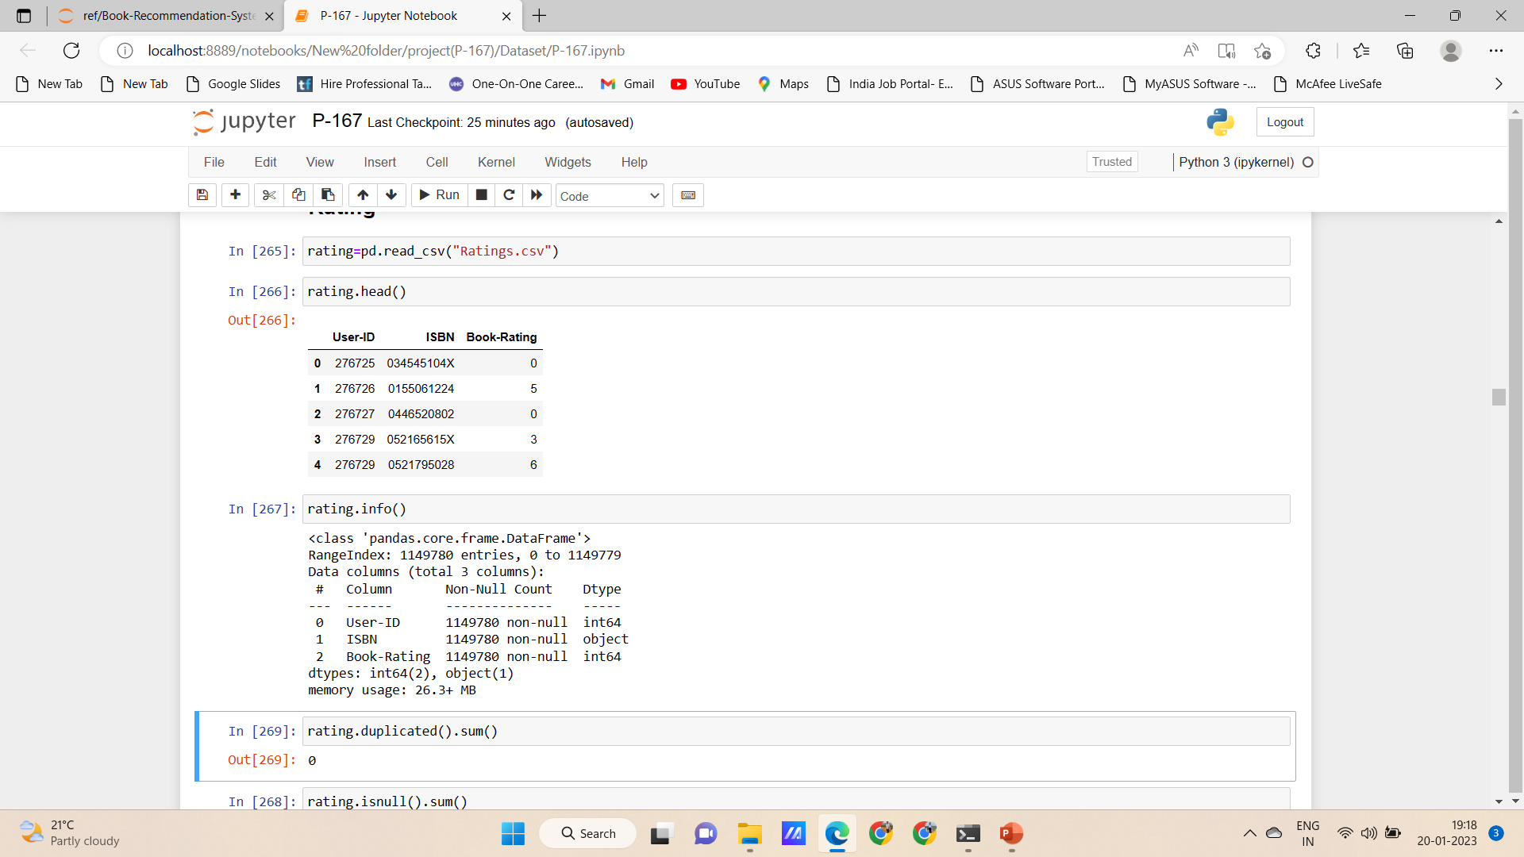
Preprocessing of Ratings
In the Rating dataset null values are dropped and the no duplicated values are present
Distribution of the rating is shown and from that it is clear that more rating is zero but the information of the dataset specifies that rating is in the range of 1-10 and hence 0 is not the rating
There are ratings for some books that are not in the books dataset and hence they are removed
The books that are rated not present in the books dataset is 118652

Slide 9
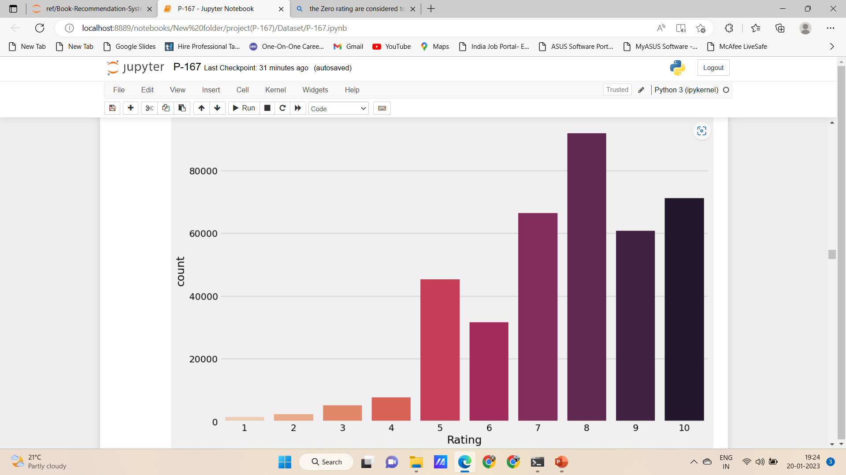
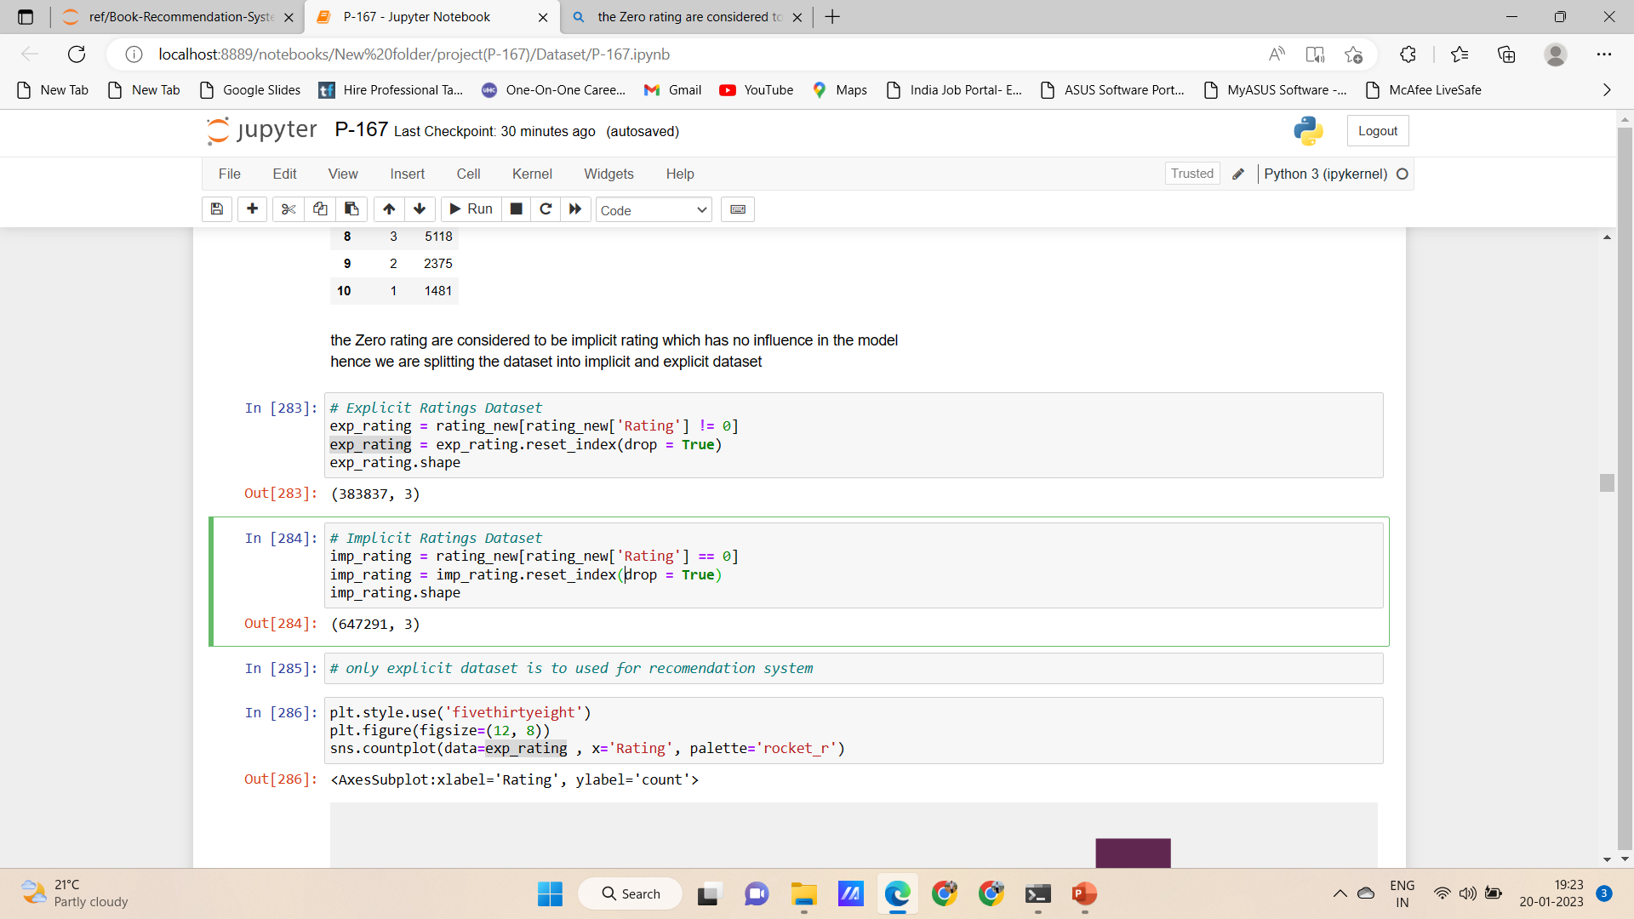
Preprocessing of Ratings
the Zero rating are considered to be implicit rating which has no influence in the model hence we are splitting the dataset into implicit and explicit dataset

Slide 10
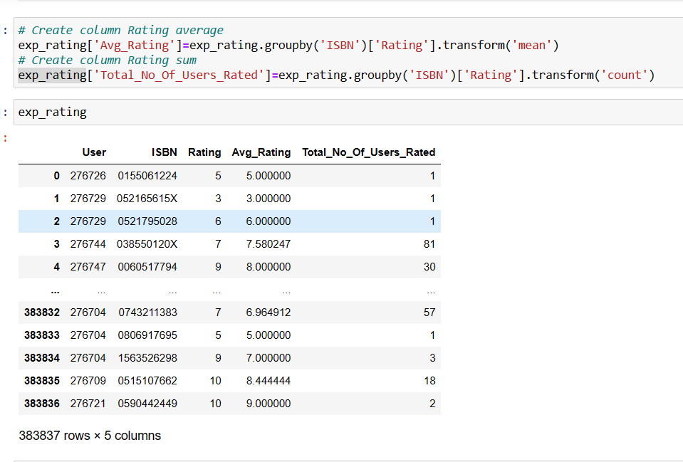
Preprocessing of Ratings
Adding the Avg_rating and total_no_of_user_rated column to find the average rating of the each books and also to find the no of user who have rated for each of the book

Slide 11
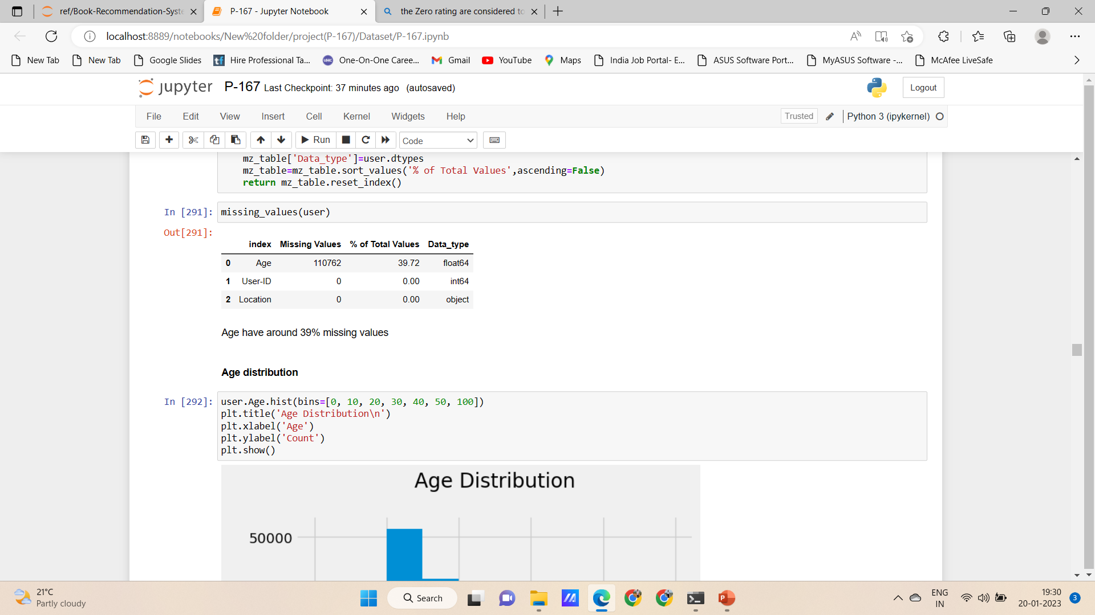
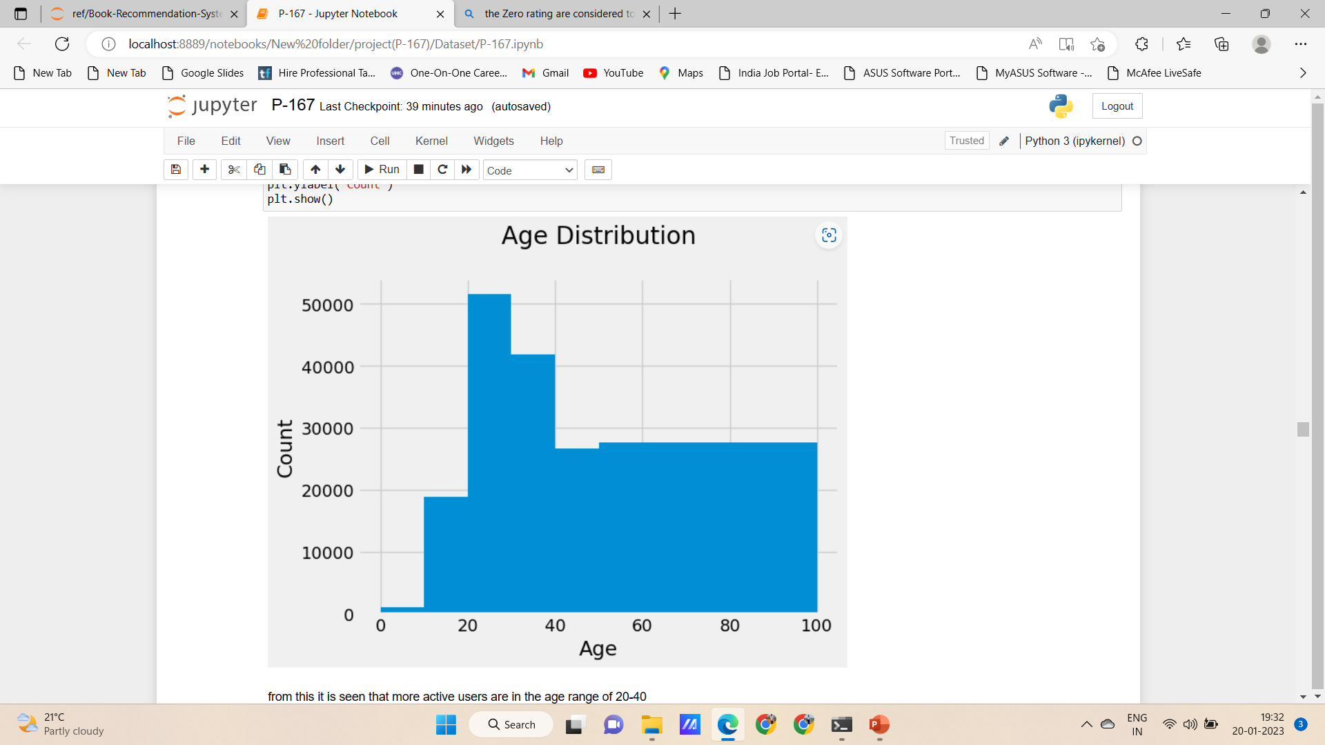
Preprocessing of Users
User dataset has three information and as User ID, Location and Age
In many age column many of the values are missing
The distribution of the age data is shown
From this majority of the books user is in the range of 20-40

Slide 12
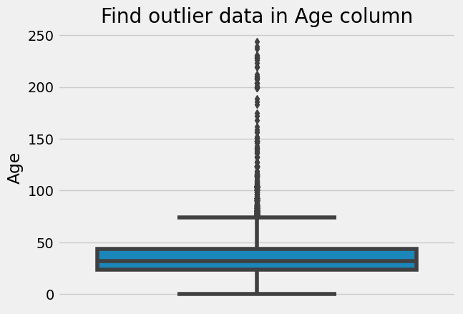
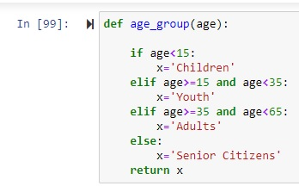
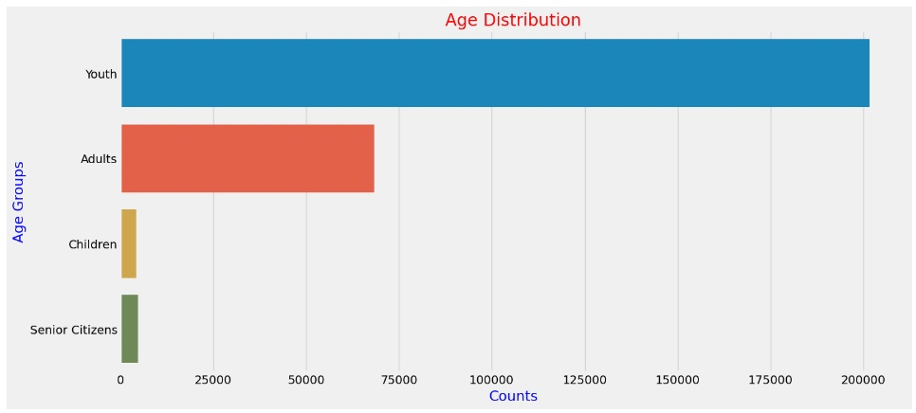
Preprocessing of Users
Checking outliers in the age column
From the find the outliers, we can conclude that the age beyond 100 are age beyond 100 which is not a sensible information
So we categorize the Users into 4 groups into Children, Youth, Adults, Senior Citizens
Visualization shows that there are more youths comparing all other groups

Slide 13
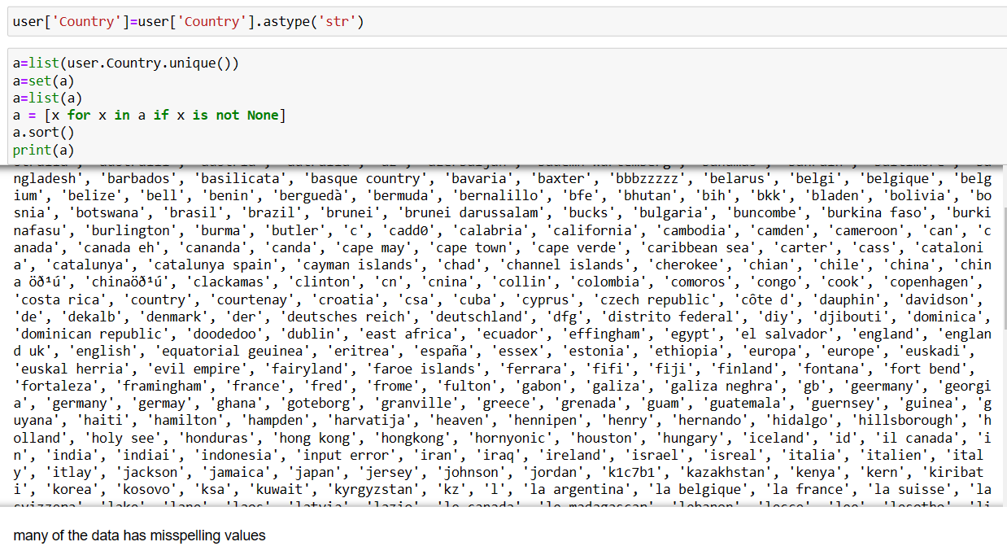
Preprocessing of Users
In the location column the data is as city, state, country and many are unique(57339) with different spellings and to make it appropriate for the recommendation system we only extract country from the columns

Slide 14
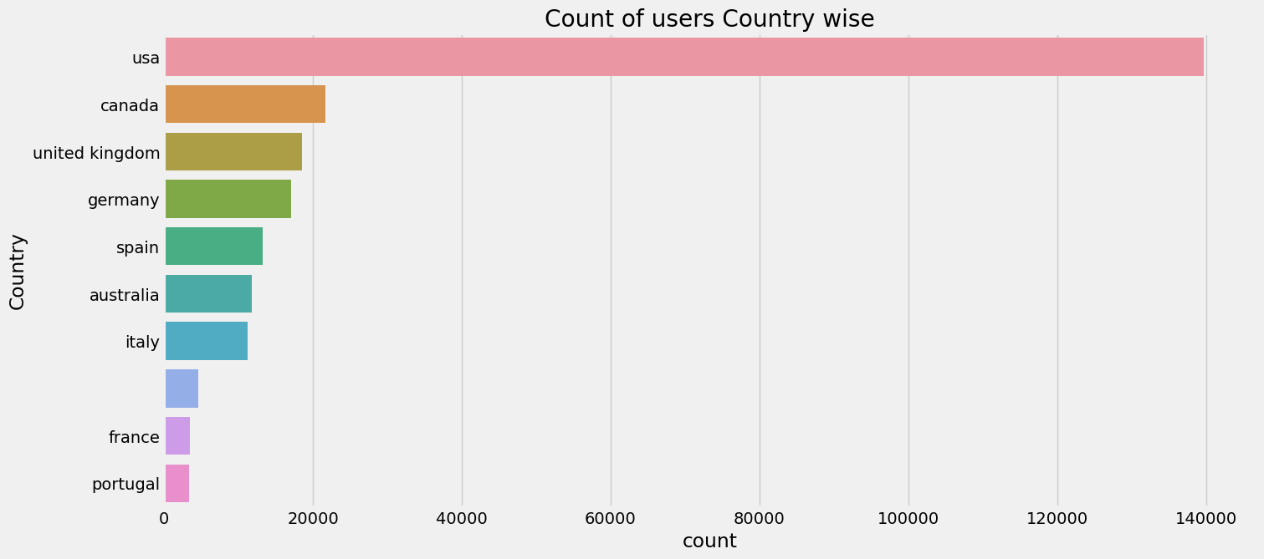
Preprocessing of Users

Slide 15
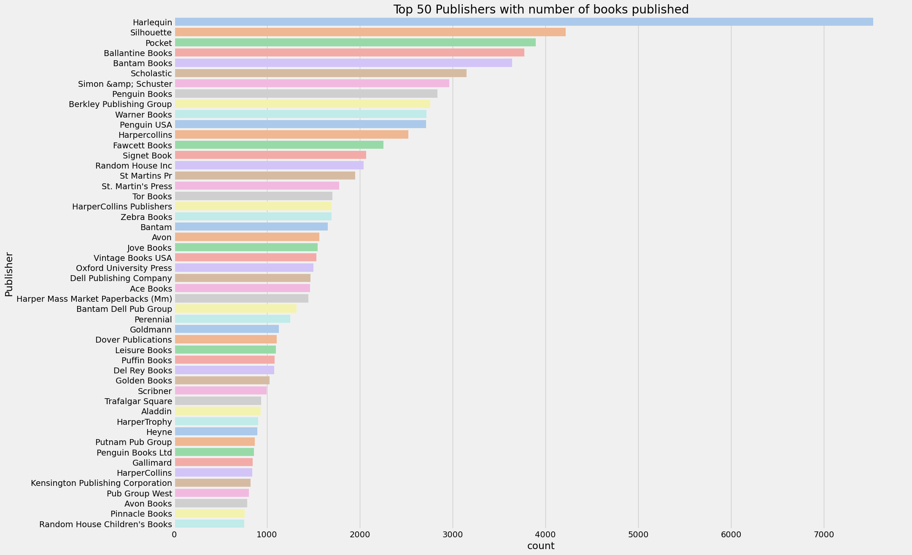
Top 50 Publishers with number of books published:
Harlequin has most number of books published, followed by Silhouette
We can observe Harlequin publisher's marking better performance than any other publishers

Slide 16
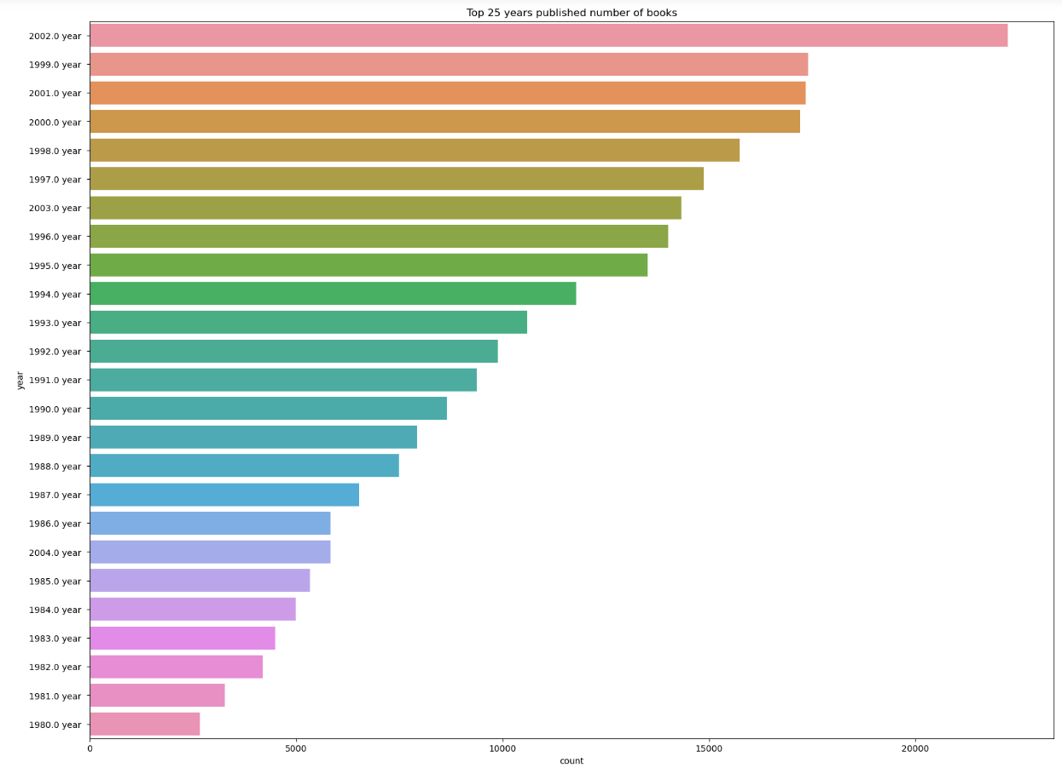
Top 25 years published number of books:
In this graph the year 2002 is found to be maximum because this value has been imputed as mode

Slide 17
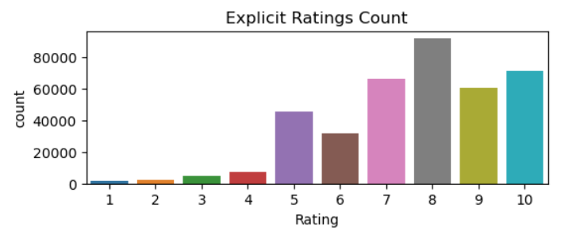
Explicit ratings count:
Most books are rated 8 by the users

Slide 18
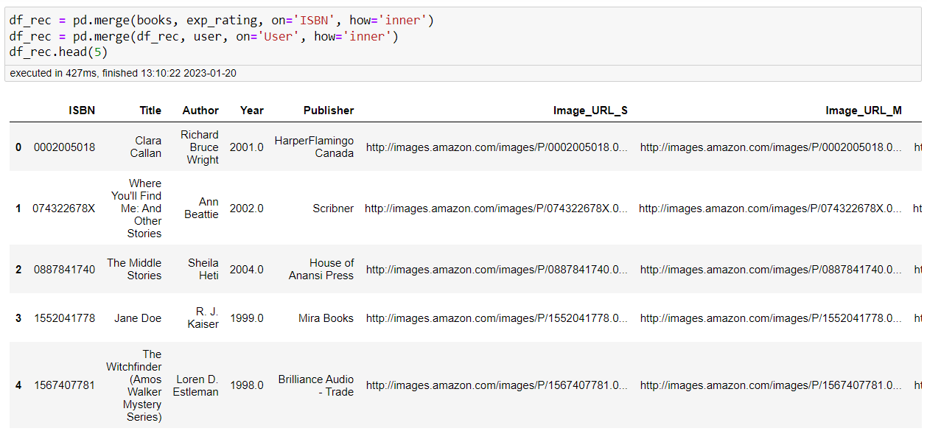
Merging all the 3 datasets in to one dataset
Shape is 383837 rows and 11 columns

Slide 19
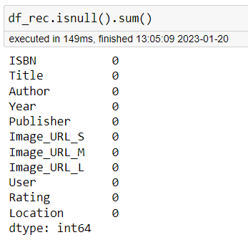
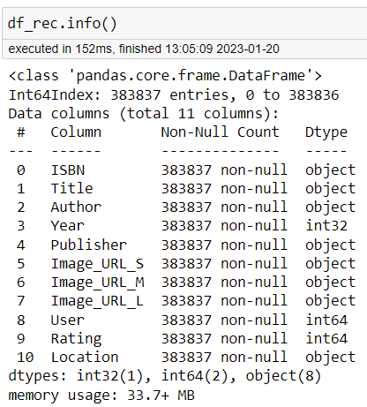
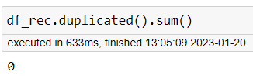
Null values
Info of merged dataset
Duplicates

Slide 20
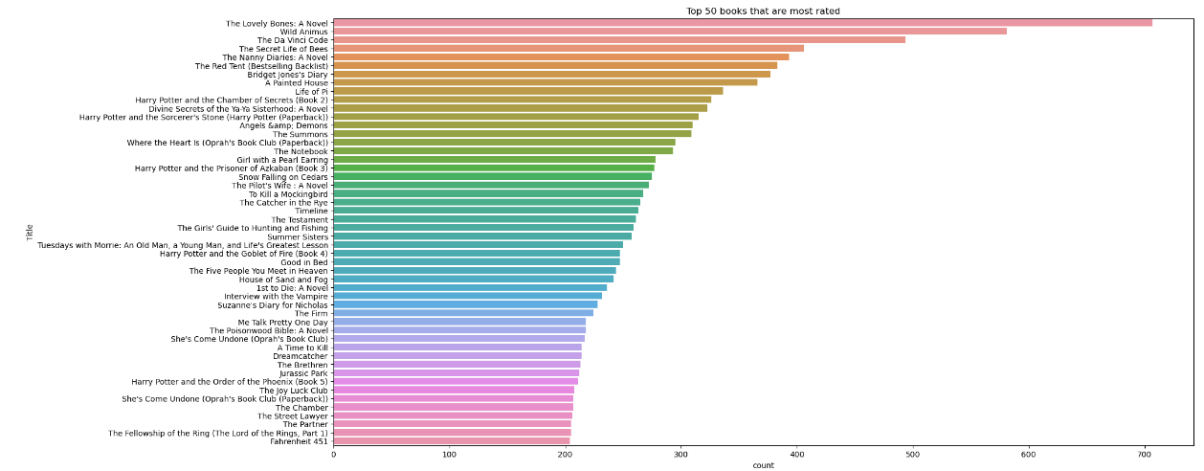
Top 50 books that are most rated:
The Lovely Bones: A Novel is mostly rated book by users followed by Wild Animus book

Slide 21
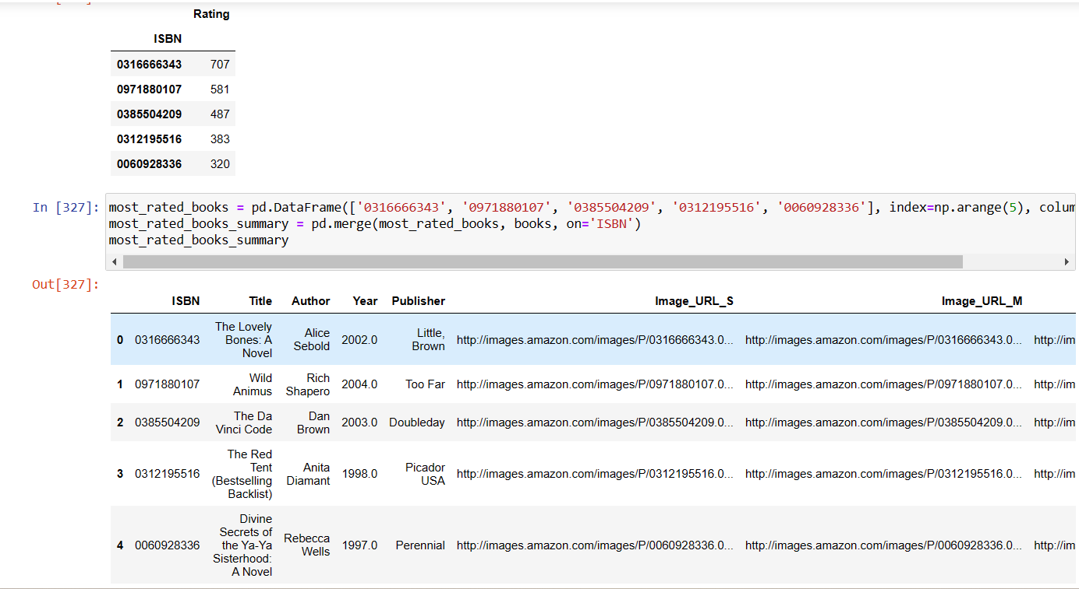
Top most rated books details:
The Lovely Bones: A Novel is mostly rated book by users followed by Wild Animus book

Slide 22
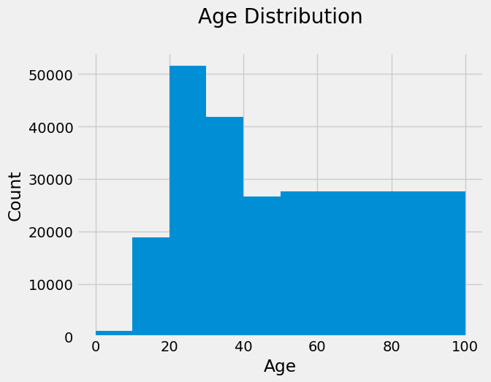

Modification on the age column:
40% of the total data in the age column is missing
Also the majority of the available datas age group lies in the age range of 20-40 who are considered to be young and middle aged adults
The available data in the age column , also consists of large number of outliers that is many age are above the range of 90 which is not practically possible and also some age are zero

Slide 23
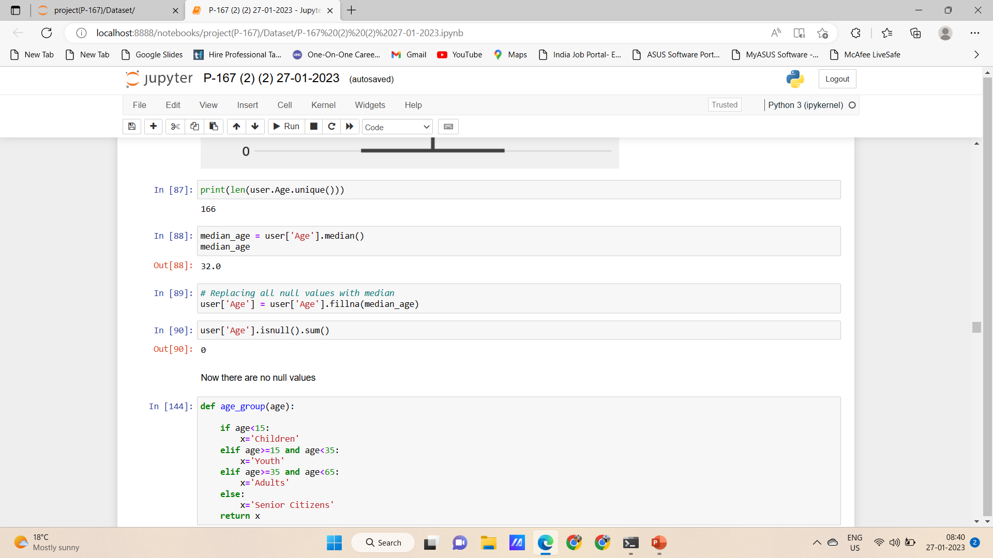
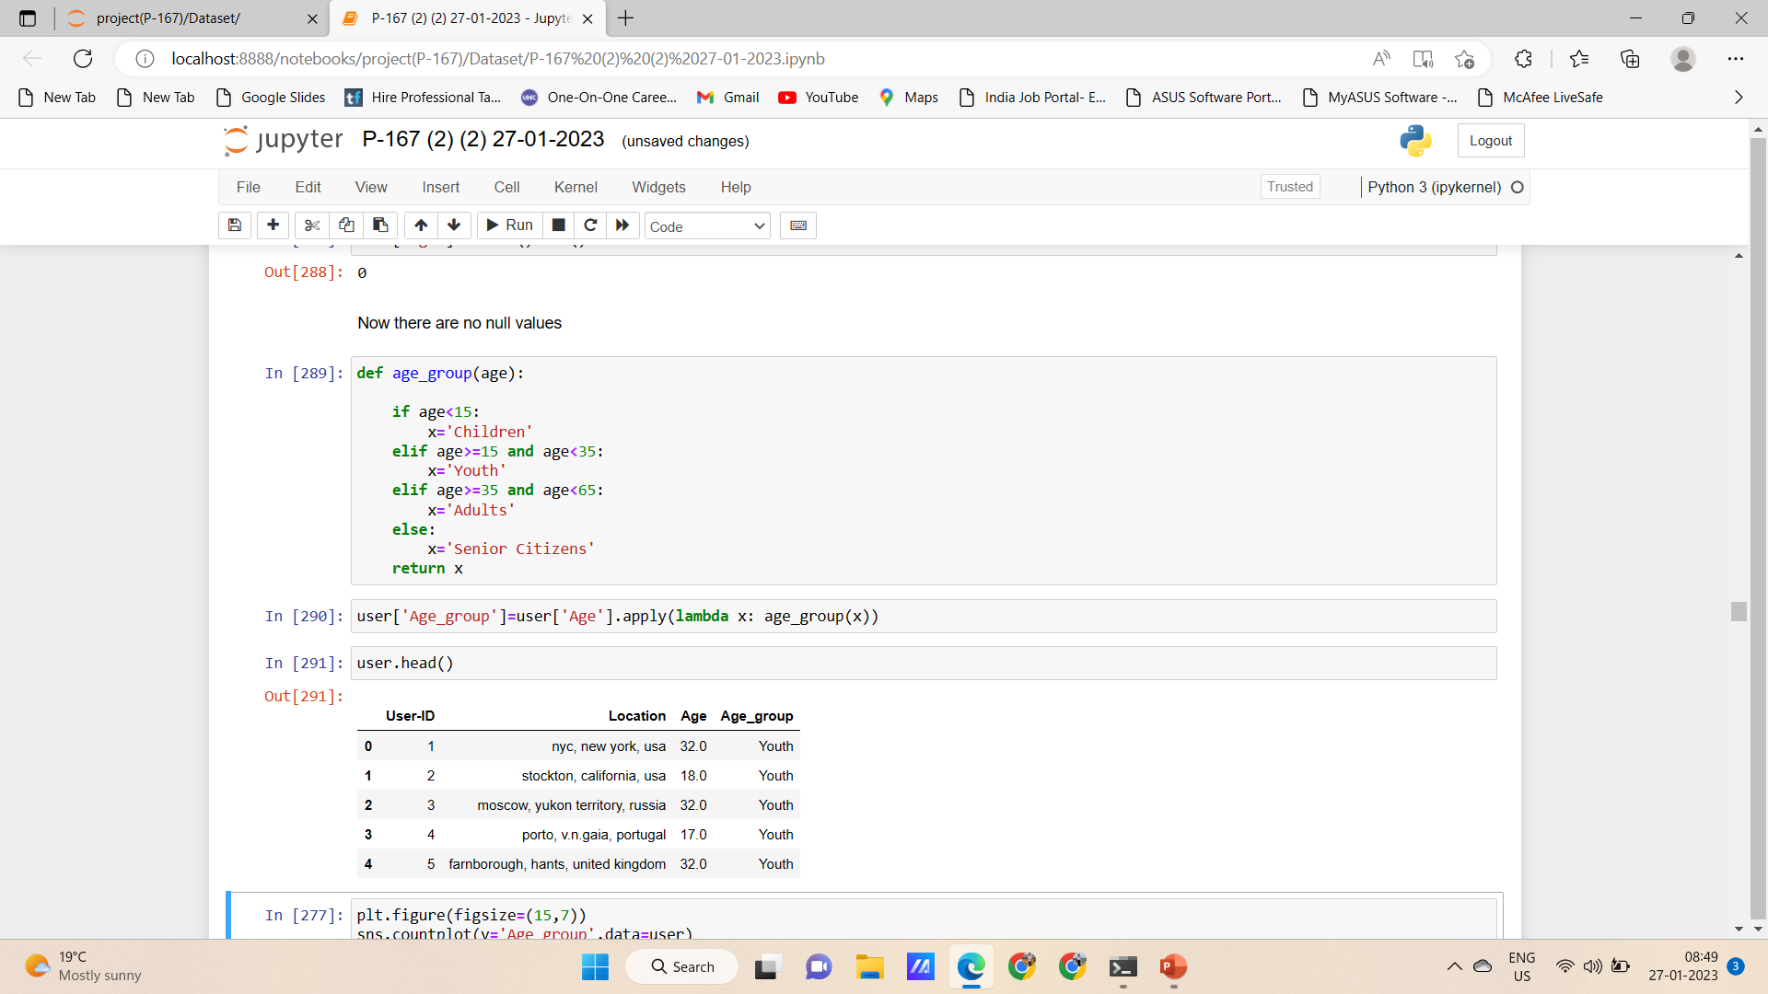
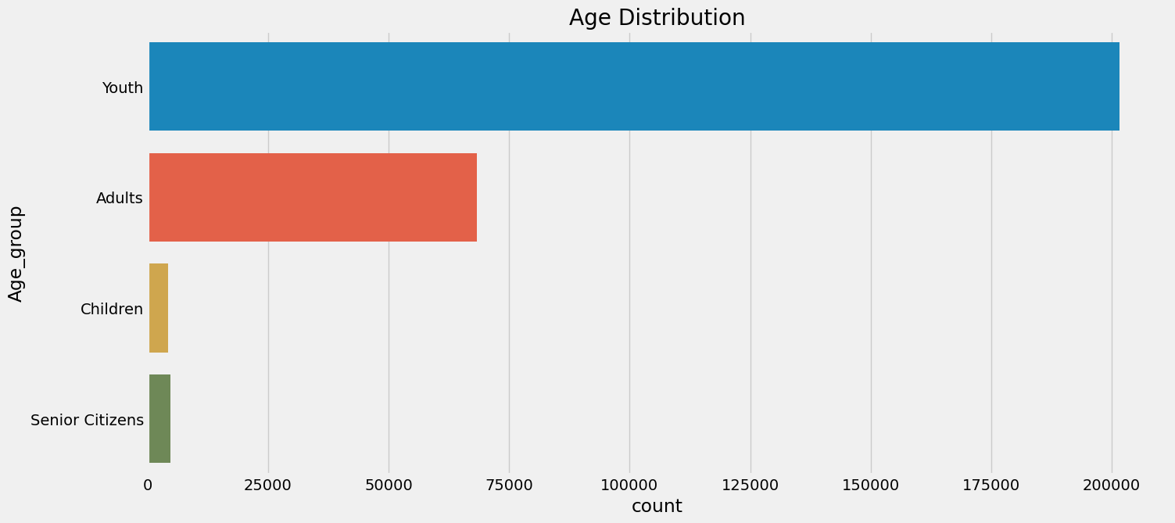
Modification on the age column :
The missing values of the age are imputed with the median
The age is classified into the 4 categories with a specified range

Slide 24
Model Building for the recommendation
The major types of models to build recommendation system are:
Popularity based recommendation system
Content based recommendation system
Collaborative filtering based recommendation system
Item – Item based recommendation system User-user based recommendation system
4. Hybrid recommendation system

Slide 25
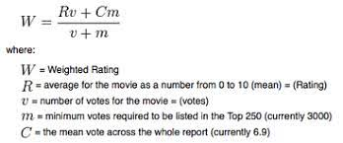
Model Building-01
Model-01 Popularity based filtering:
As the name suggests Popularity based recommendation system works with the trend. It basically uses the items which are in trend right now. For example, if any book which is usually bought by every new user then there are chances that it may suggest that book to the user who just signed up.
Book weighted average formula is given as follows:

Slide 26
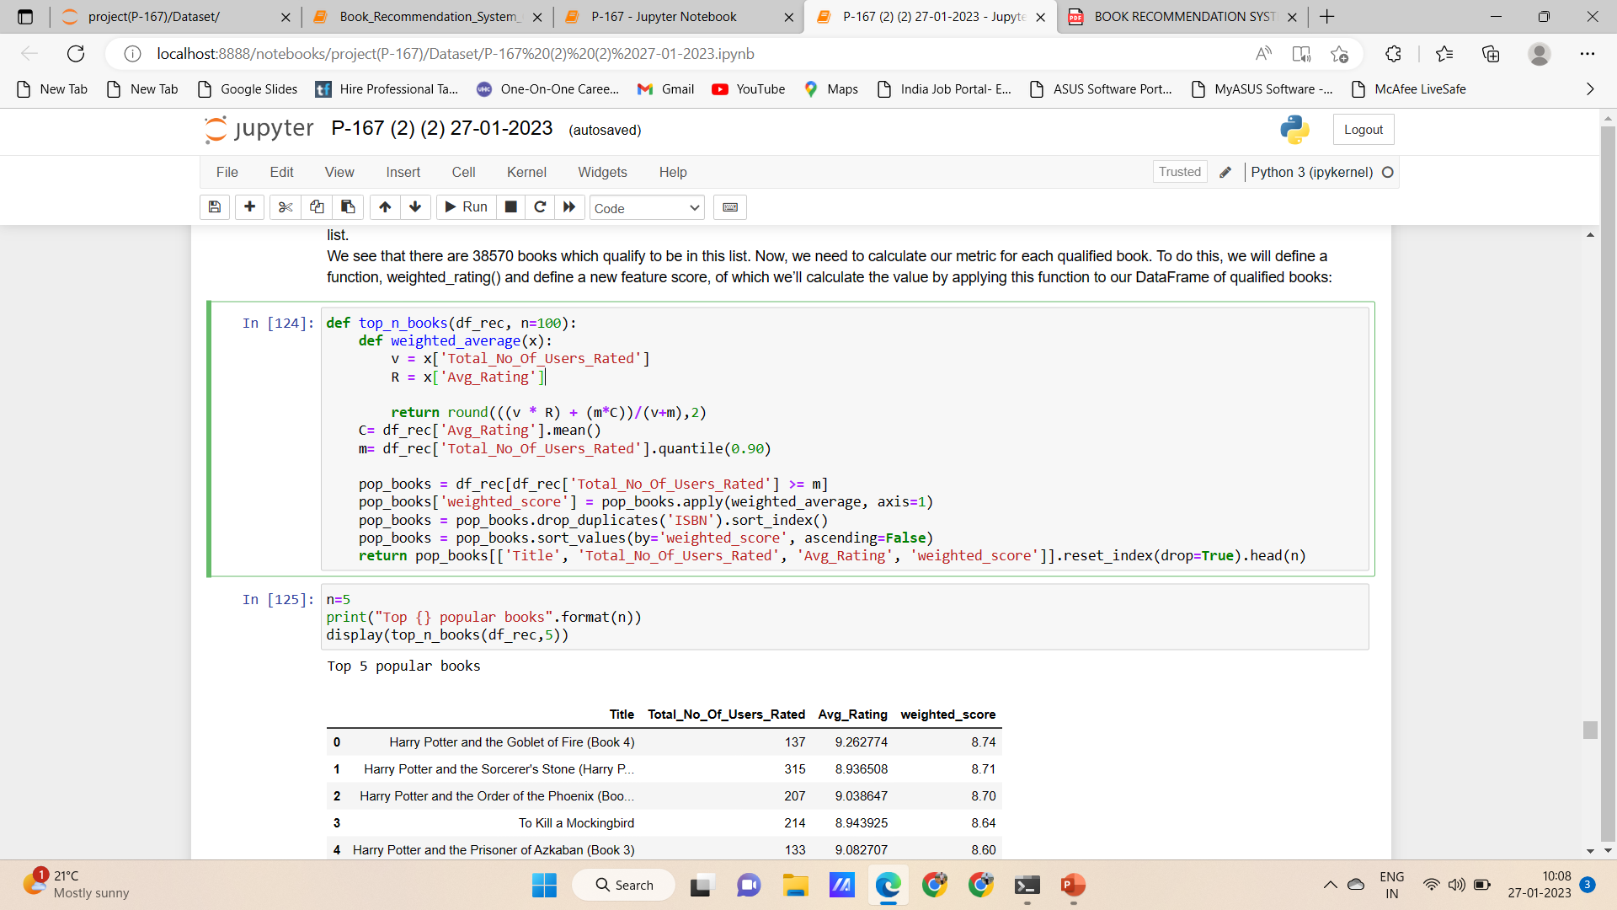
Model Building-01
Popularity based model:

Slide 27
Model Building-01
Here we used 90th percentile as our cutoff. In other words, for a book to feature in the charts, it must have more votes than at least 90% of the books in the list.
We see that there are 38570 books which qualify to be in this list.
Now, we need to calculate our metric for each qualified book.
To do this, we will define a function, weighted rating() and define a new feature score, of which we’ll calculate the value by applying this function to our Data Frame of qualified books:

Slide 28
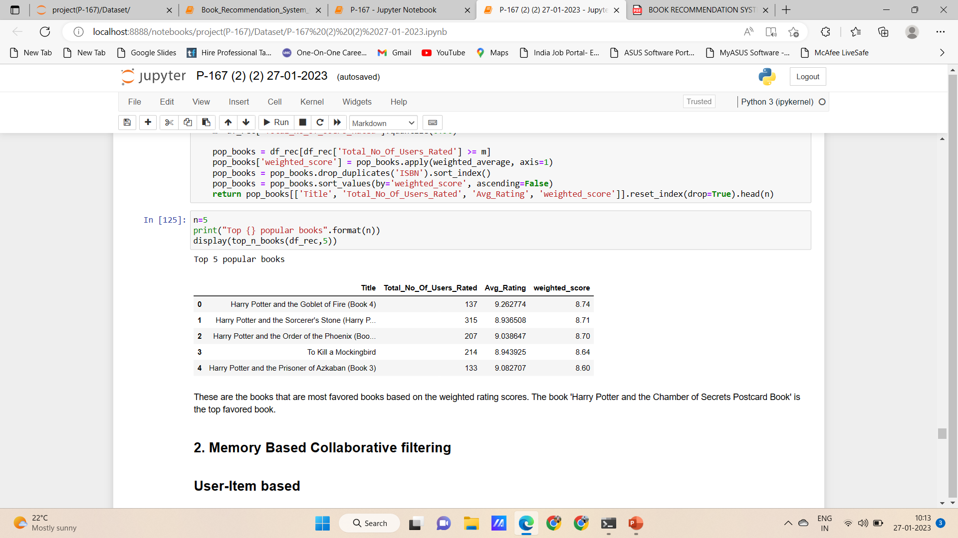
Model Building-01

Slide 29
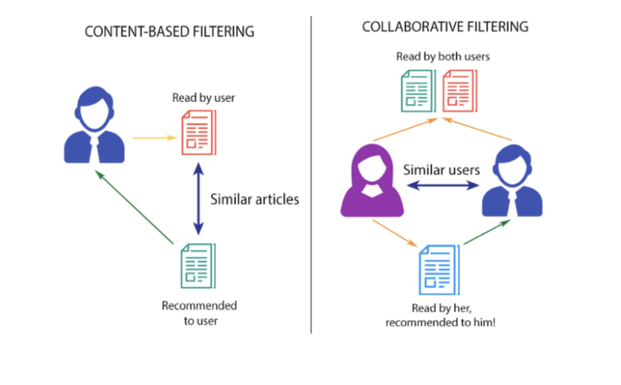
Model Building-02

Slide 30
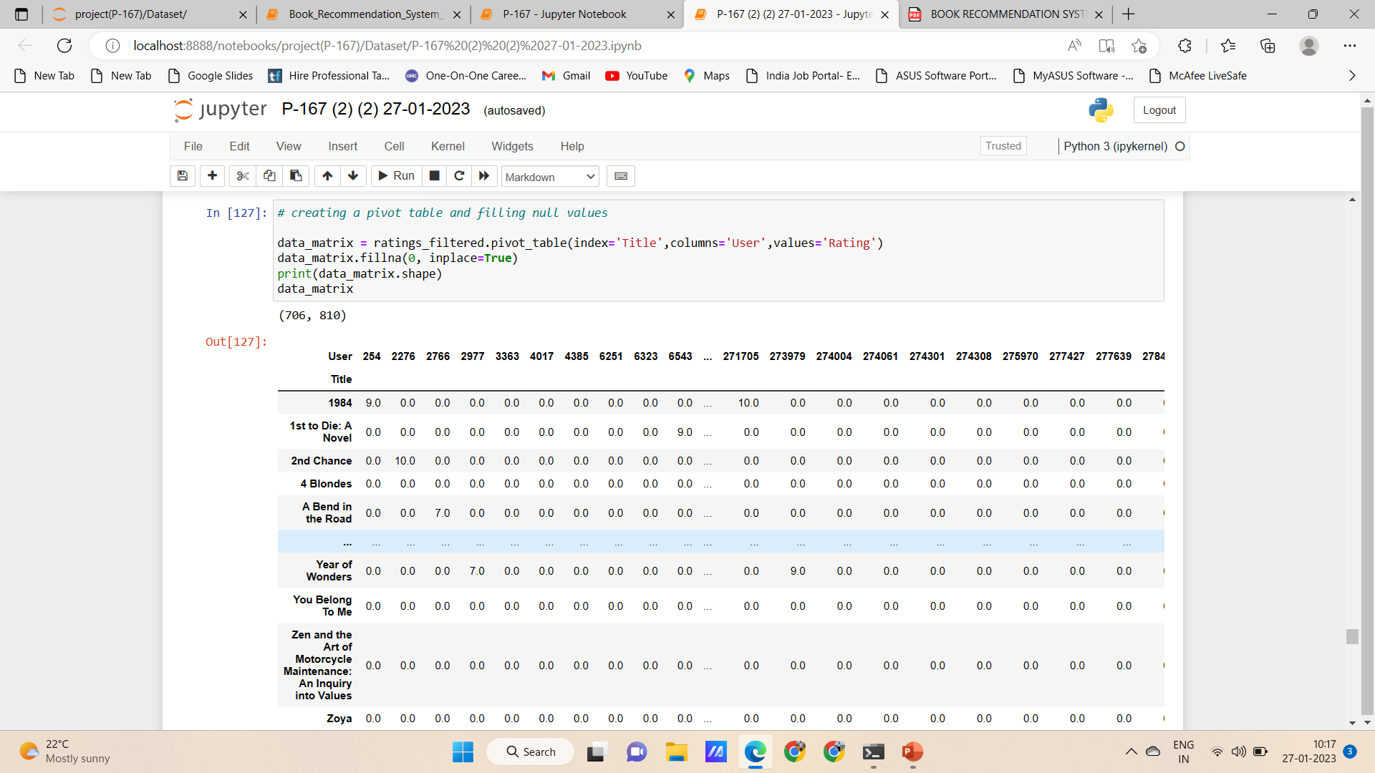
Model Building-02

Slide 31
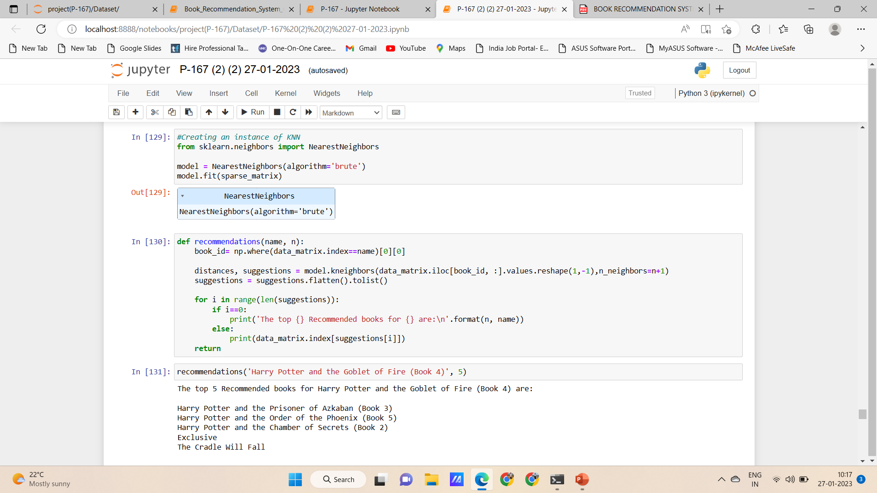
Model Building-02

Slide 32
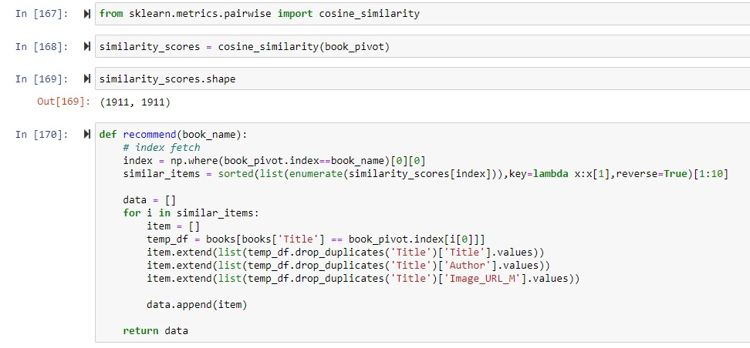
Model Building-03

Slide 33
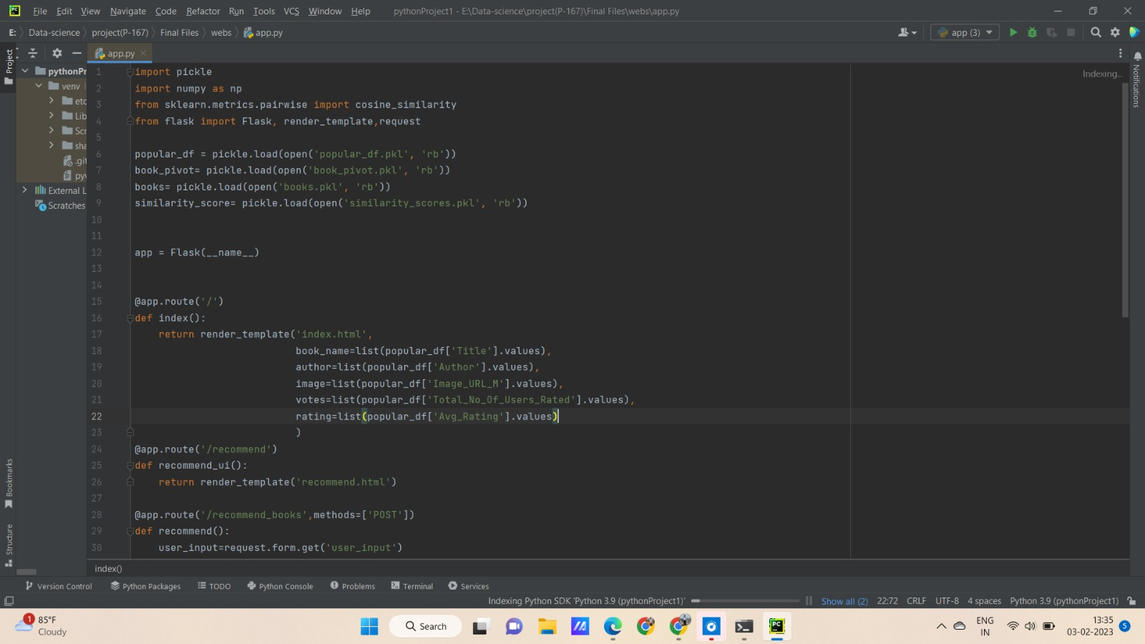
Model deployment Using flask

Slide 34
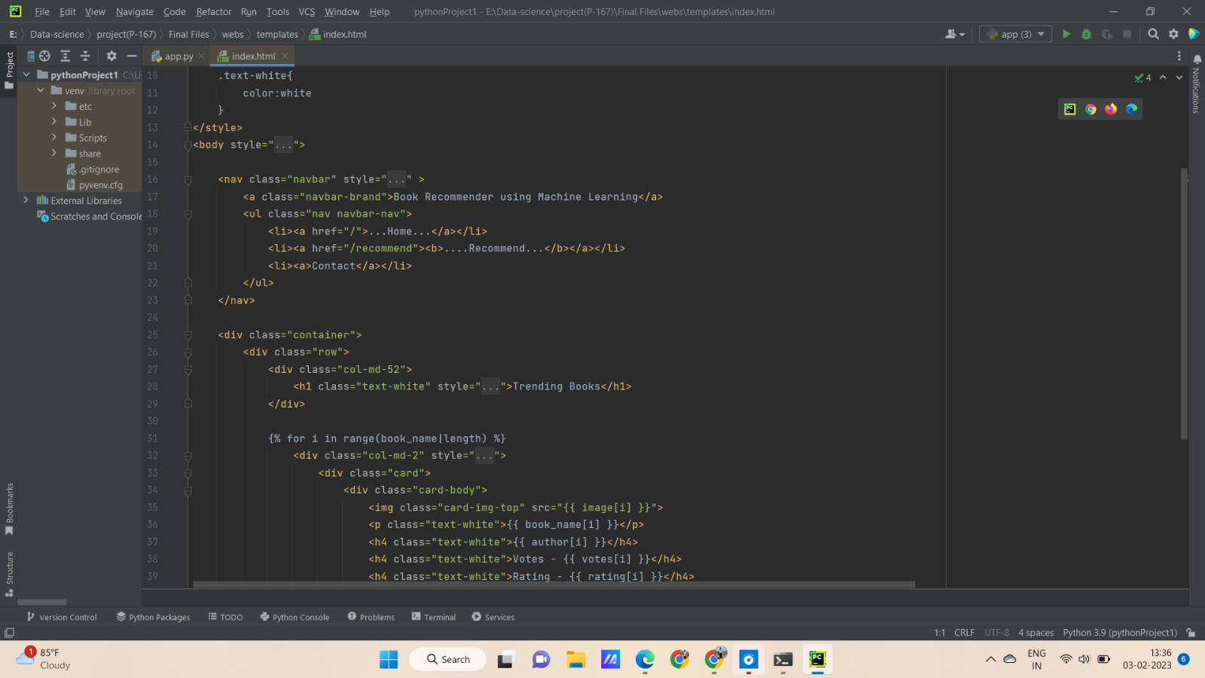
Deployment

Slide 35
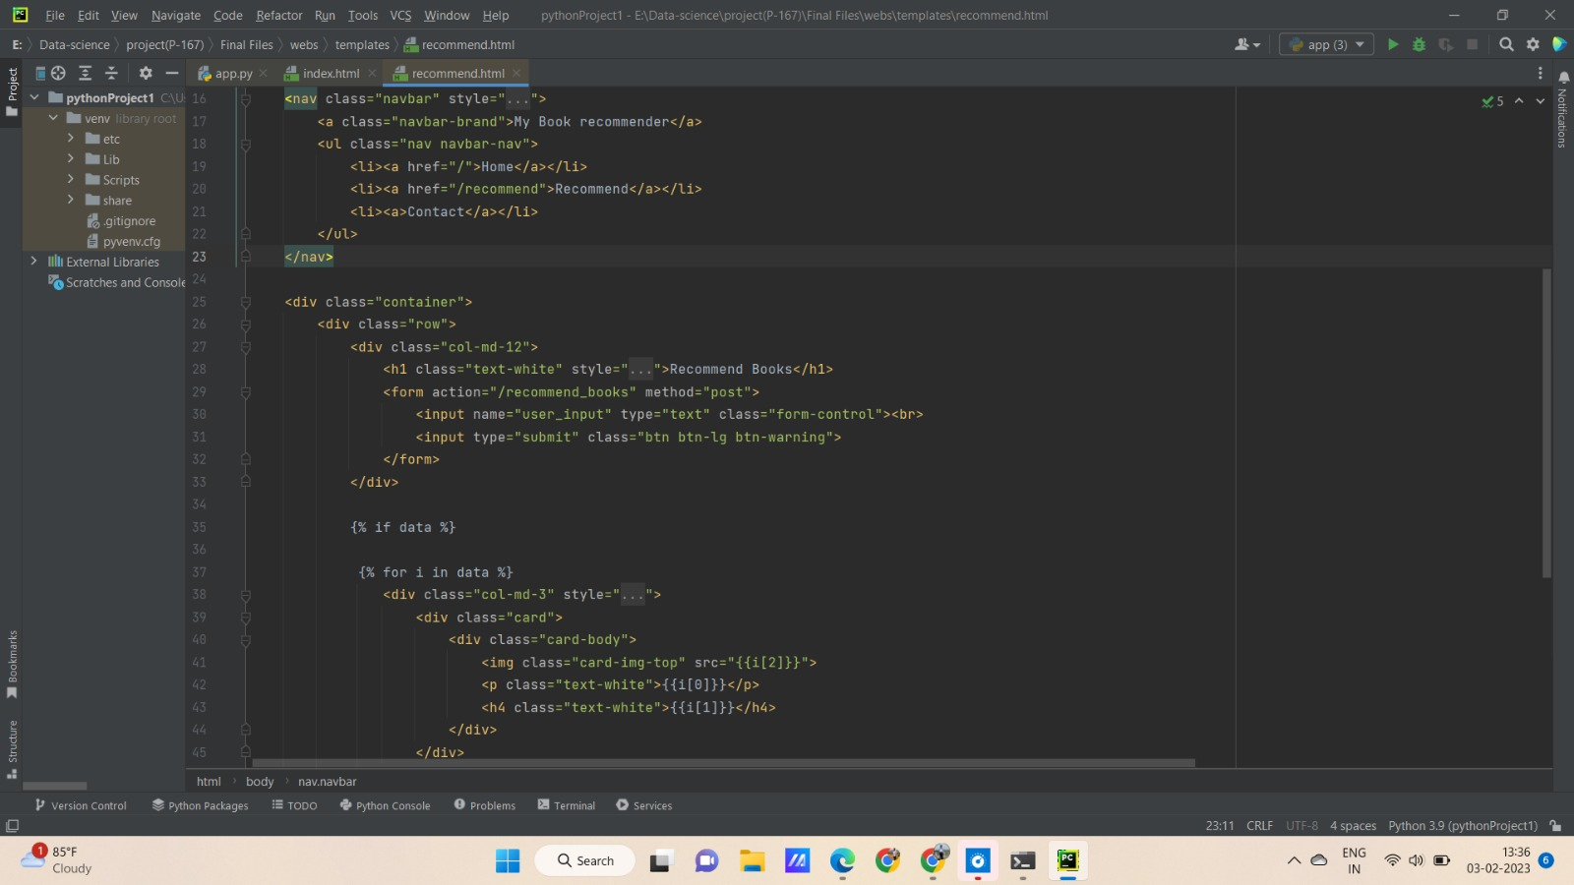
Deployment

Slide 36
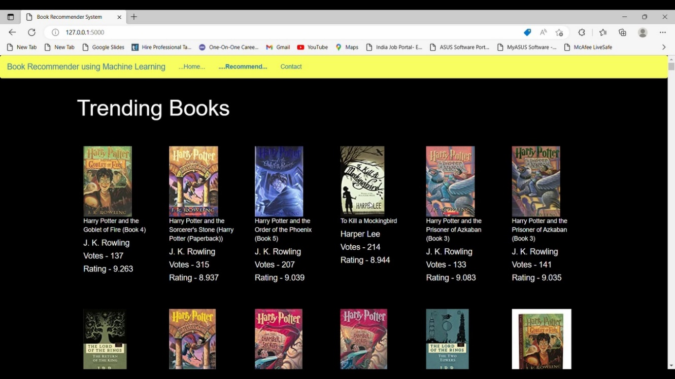
Deployment – Popularity based

Slide 37
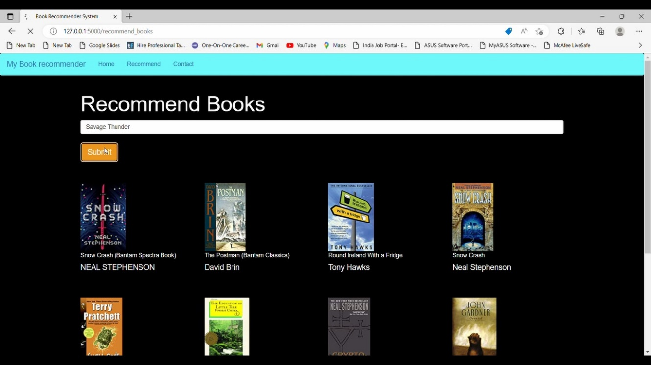
Deployment- model

Slide 38
challenges & Learning insights
Data cleaning of the insensible data
Imputation Techniques
Some books are with multiple authors as well as there were different books with common book titles. They were identified and separated before model building.
Other methods of recommendation system has been brought to the platform of learning
Deployment method with flask has been learned.

Slide 39
Future scope
Clustering using Age, Location can be done and books can be recommended based on such clusters.
Extraction of data like genre, Language script in future could help in building narrowed recommendation engine to the user.
Hybrid collaborative recommendation could be made by combining two or more models

Slide 40
Conclusion
Book Recommendation Engine using three models have been successfully implemented
Insights
Most Popular Book- The Lovely Bones : A novel
Most Popular Publisher- Harlequin
Most readers age- 20 to 40 years
Most Readers Country – United States of America
Comparing all three models built, Model built using collaborative filtering technique has been observed to be performing better than other two models

Slide 41
Thank you!!!

